Slide 1
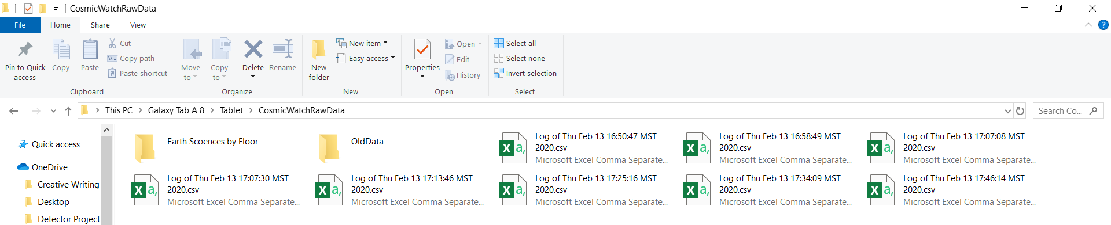
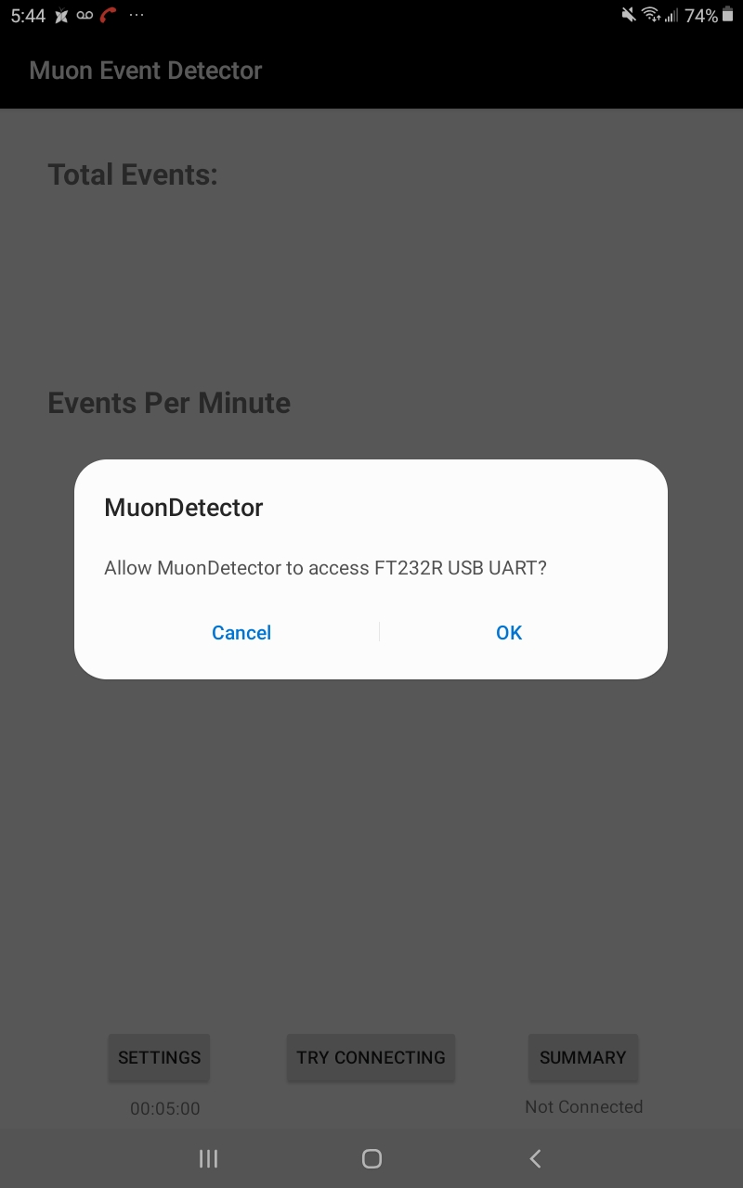
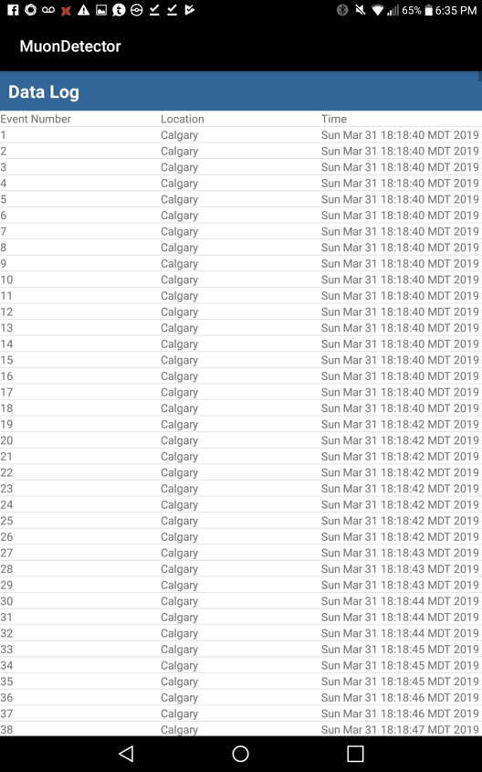
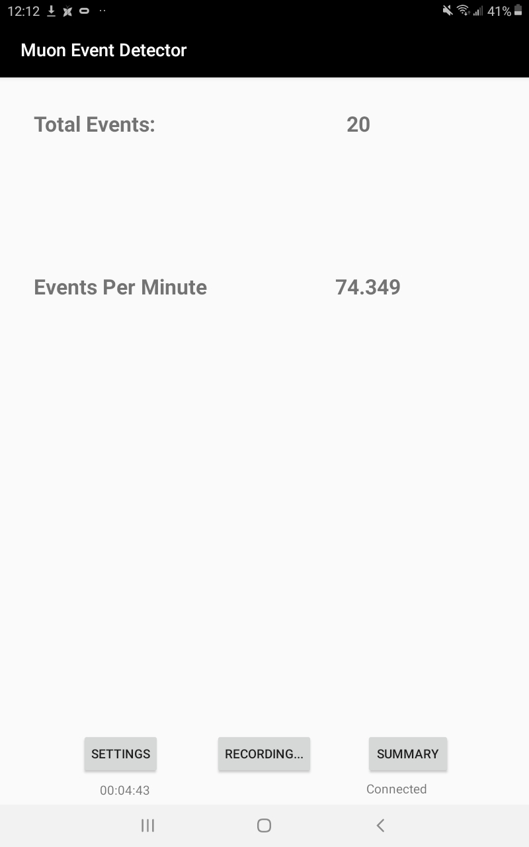
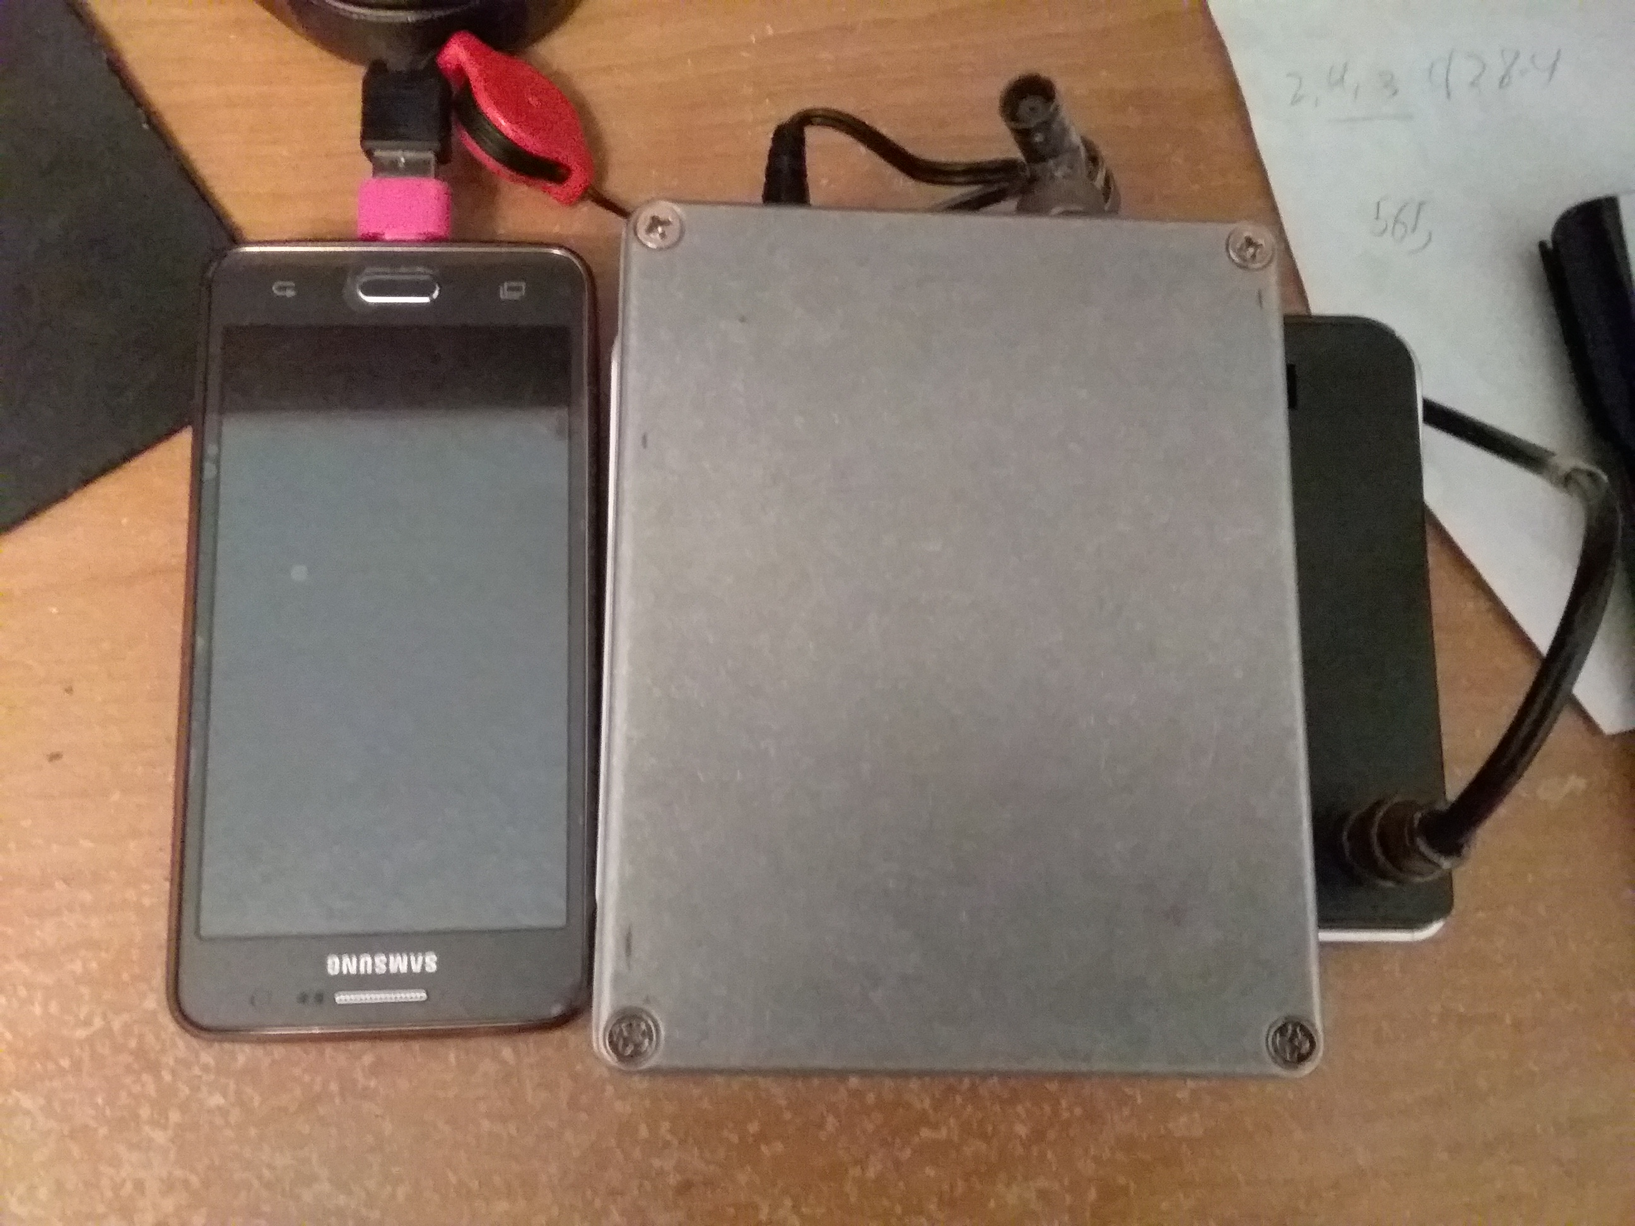
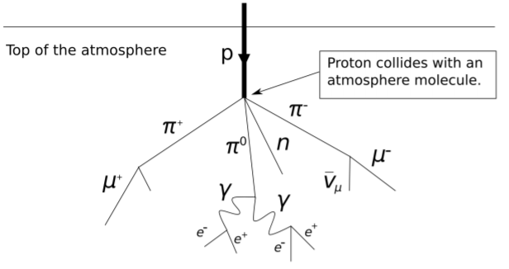
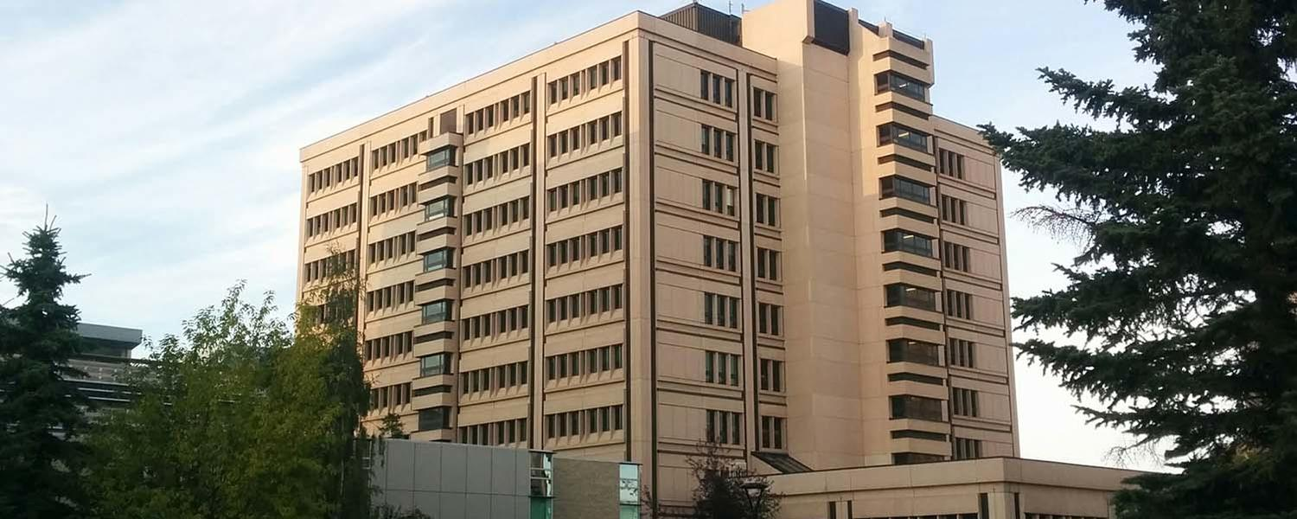
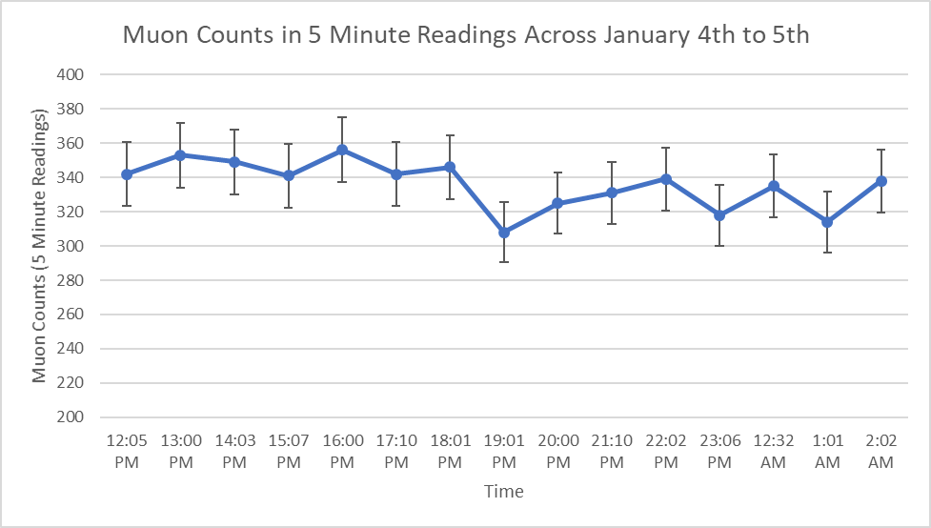
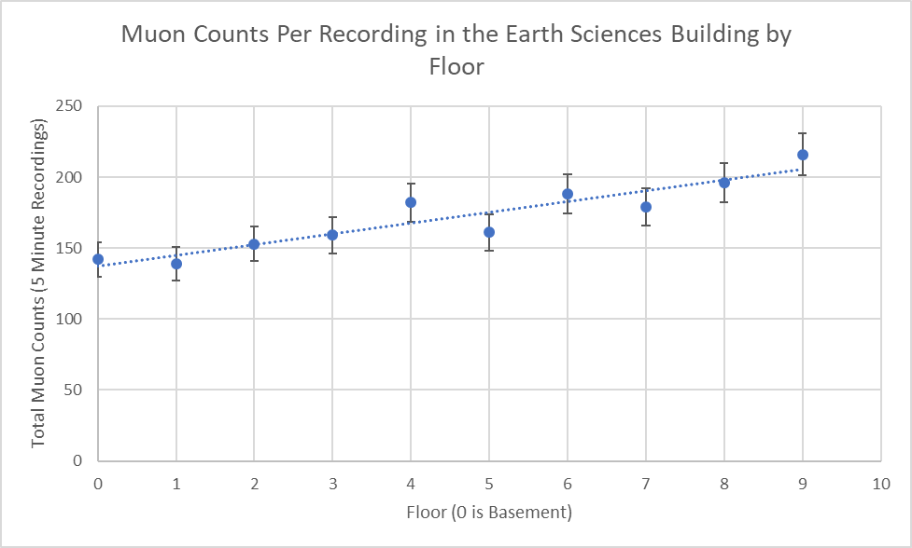
COSMIC WATCH MUON DETECTOR
ANDROID APPLICATION FOR MUON DETECTOR PERIPHERAL
J.M. Ngo and J.M.K.C. Donev
(University of Calgary) (Department of Physics)
Increased Convenience and Portability enables use at a ‘high school’ level educational setting, and to gather locational data across a wide variety of locations.
Project Motivation
Application Background
Simple Android Application pairs portable muon detector peripheral with equally portable Android-based device.
Typical Android device envisioned is the phone – ubiquitous, portable, lightweight. Combined phone-detector system remains small, portable, and lightweight.
Backpack portable detector, or ‘record then move’ use cases.
Cheap (<$400), lightweight and portable Arduino-based muon detector by Jordan Hanania [1] with inspiration from MIT’s related project [2].
Hamstrung by required connection to large laptops with unintuitive GUI; phones and apps are an ideal replacement for these large laptops.
Increased convenience and portability enables use at a ‘high school’ level educational setting and makes field research more convenient.
Figure 1: Raw Reading Data saved to CSV files for later usage
Application Capacities:
Detect and Connect to Arduino based muon detector via USB-mini to USB-mini (extension cords highly recommended).
Phone supplies 5v operating power to the detector.
Records line-by-line muon detection events as raw data.
Displays the tally, location, and time of each detection event.
Save raw data and processed detection data into a CSV file on the device, for future data processing applications.
Rapid events-per-minute updating for ‘live’ observation of the cumulative muon detection rate.
Other data analysis features, such as charts and graphs, intended by later updates.
Figure 5: The Muon Detector with Android Phone setup. The phone supplies the 5v operating power for the detector through the USB cable, with the entire package remaining small and easily portable, with little setup.
Figures 2, 3, 4: Detecting and Connecting, Line-by-line Display, Live Recording Features
Simple Experiments: Educational Uses and Convenience Potential
Why Cosmic Muons: Theoretical Background
These ‘High School’ level sample experiments represent simple scientific inquiries easily conducted by anyone with an android phone and the detector.
Cosmic ray muons come from all directions in space, generated in collisions between cosmic rays and the Earth.
A major source of natural background radiation.
Short muon lifetime illustrates Einstein’s theory of relativity.
Sample Experiment 1: Muon Detections over a Day
Sample Experiment 2: Muon Detections by Floor Level
Purpose: Determining if the time of day can vary the number of muon detection events, and thus if the sun or other celestial bodies matter.
Methods: Single location, Five-Minute Readings, Once Per Hour. 12+ hour timespan, significant time before and after sunset to investigate the influence of the sun with regards to cosmic muons.
Results: No statistically significant effect; cosmic rays and their generated muons do not come from the sun, but rather from all around.
Purpose: Investigating the impact of material cover on muon detection rates, with an expectation that matter shields the detector from muons.
Methods: Cosmic muons come from the sky above, so the number of floors between the sky should serve as a good proxy. Several-minute readings across ascending floors in a tall building.
Result: A significant upward trend observed, indicating that material cover does indeed shield people from cosmic ray generated muon radiation.
Figure 6: Muon Generation from Cosmic Rays [3].
Figure 9: The Earth Sciences Building, Upper Half, Where Experiment 2 Was Conducted [4].
References:
[1] J. Hanania, “Development of a desktop muon detector,”. University of Calgary 2016
[2] S. Axani, J. Conrad, and C .Kirby, “The Desktop Muon Detector: A simple, physics-motivated machine- and electronics-shop project for university students,". Available: https://arxiv.org/pdf/1801.03029.pdf
[3] Wikipedia. (2020, May 6). Cosmic ray. Retrieved May 20, 2020, from https://en.wikipedia.org/wiki/Cosmic_ray
[4] University of Calgary. (2020, January 30). Earth Sciences Building. Retrieved May 20, 2020, from https://www.ucalgary.ca/ancillary/accommodations-and-events/conference-and-events/classrooms/earth-sciences-building
Figure 7: Experimental Results for ‘High School level’ Hourly Readings Experiment.
Figure 8: Experimental Results for ‘High School Level’ Different Floors Experiment

